Slide 1
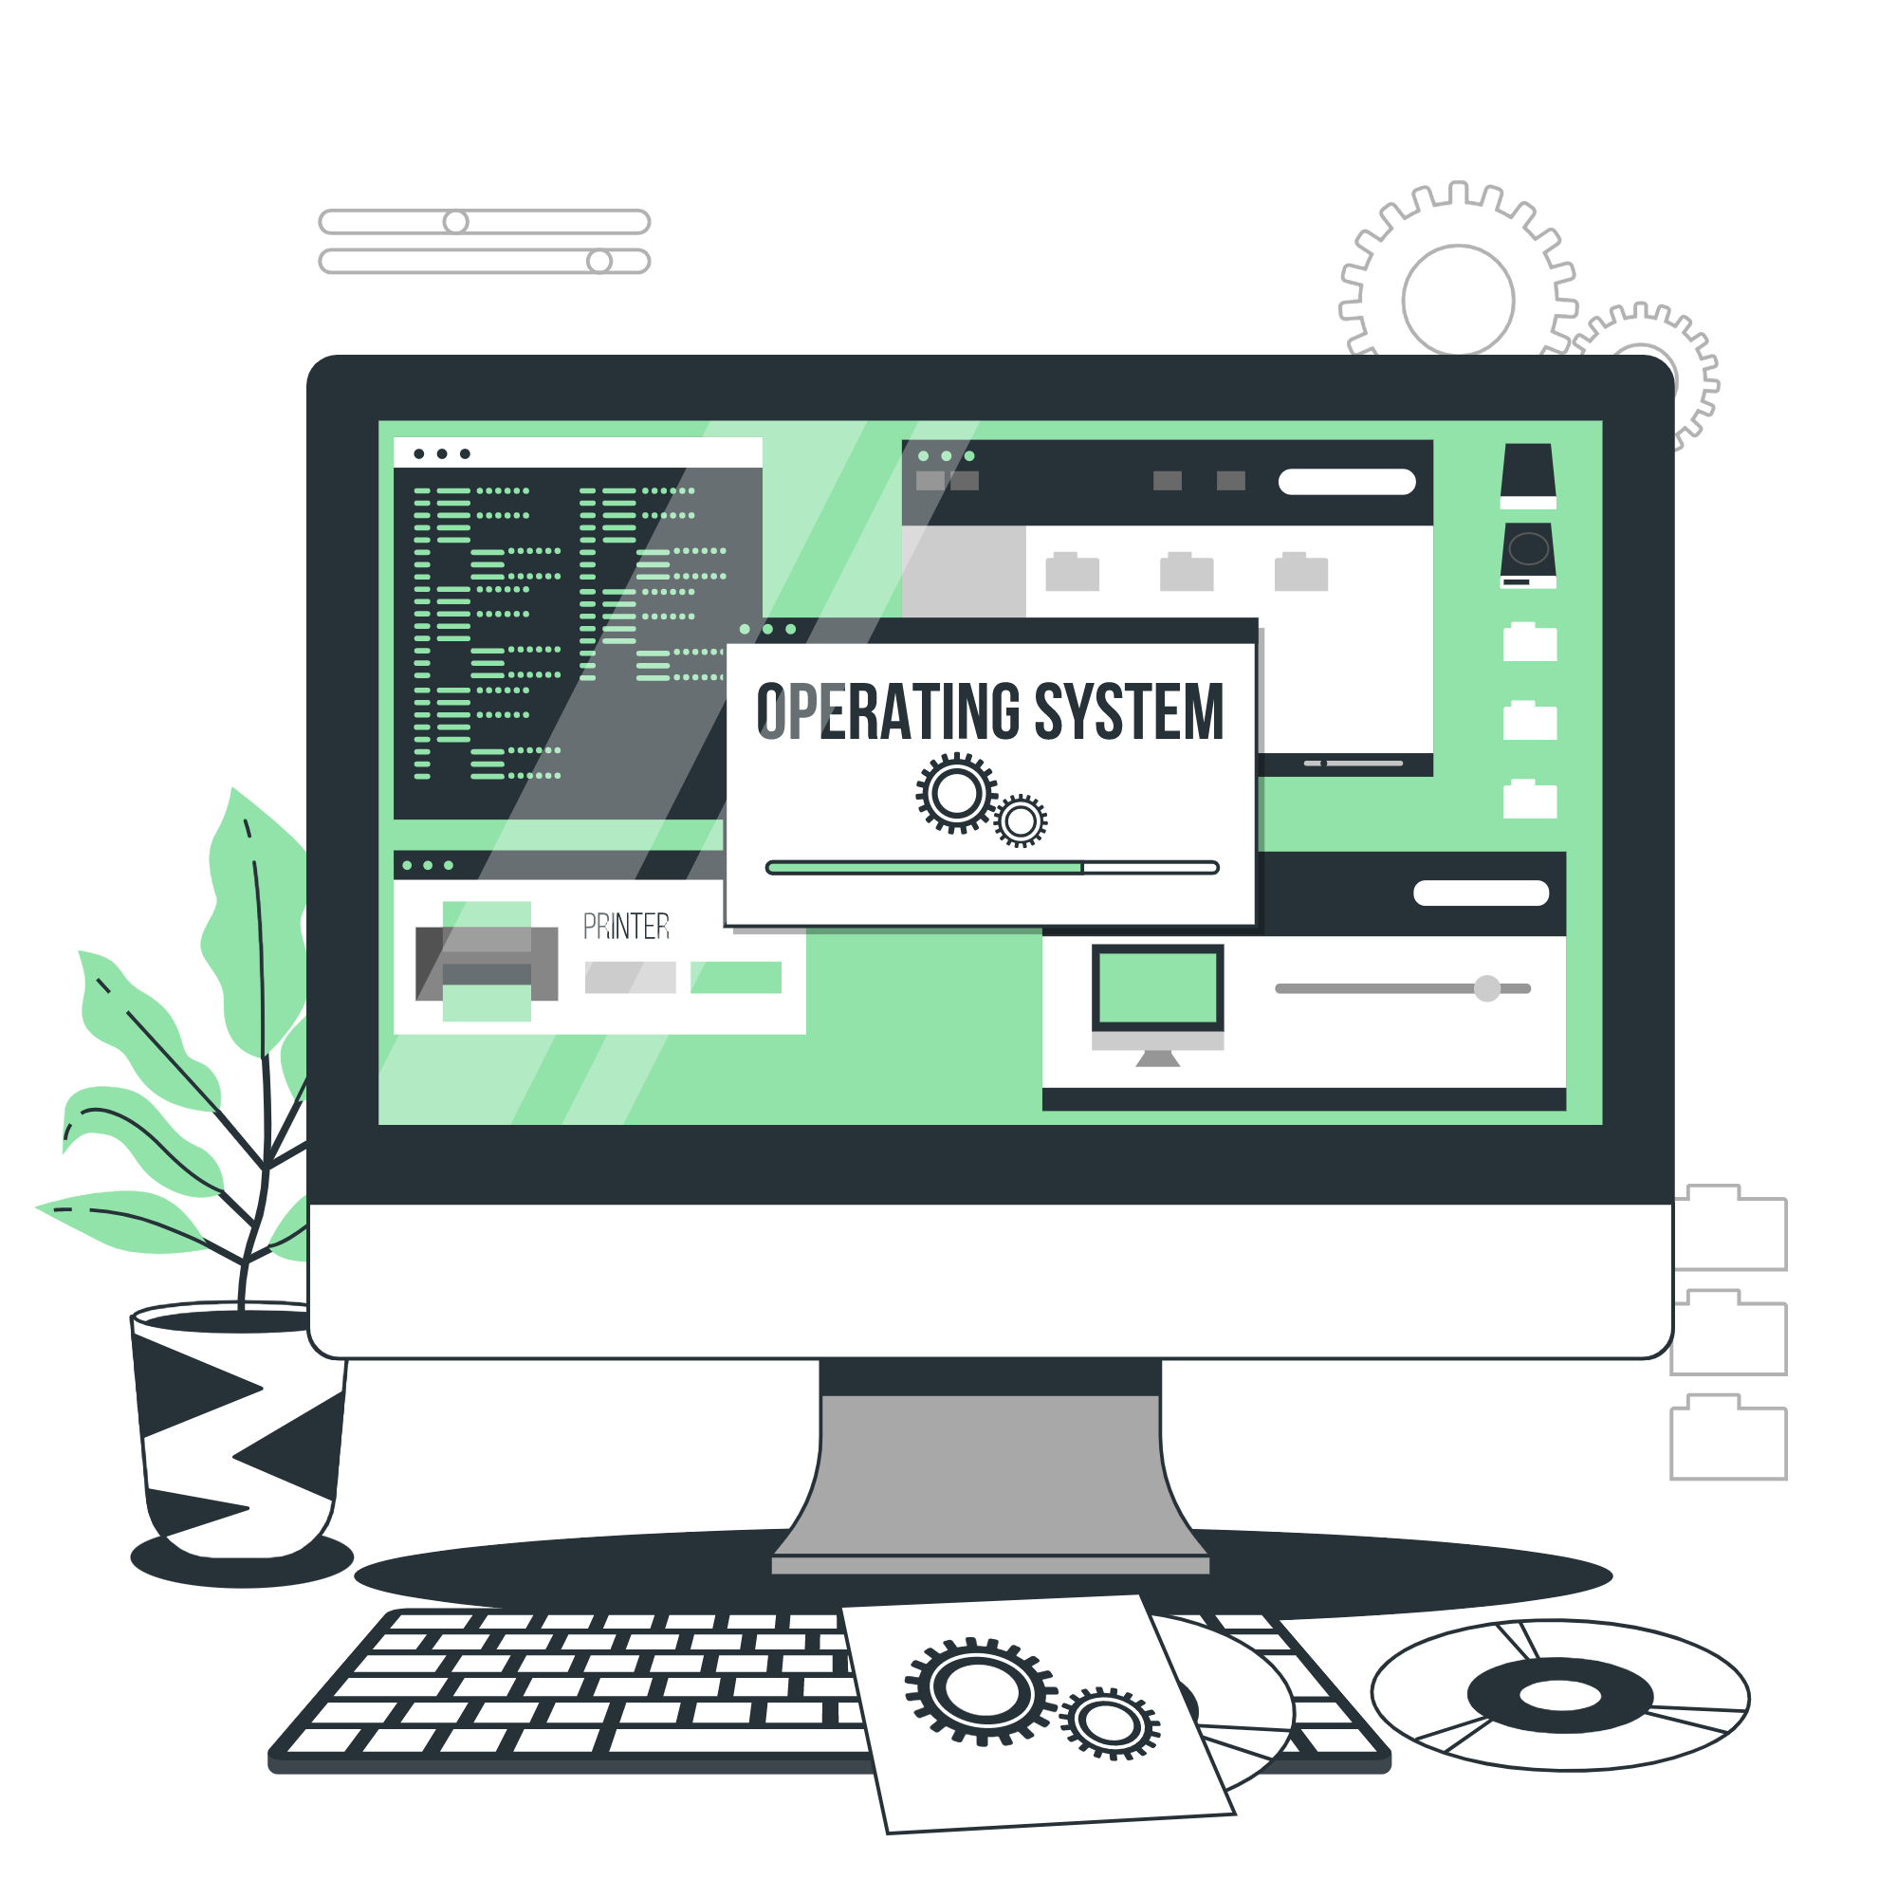
Operating Systems
Lecture : 5

Slide 2

User Interface (UI)

Slide 3


What is User Interface (UI)
A User Interface (UI) is the graphical interface between a user and a computer or other electronic device.
It includes the visual elements, such as buttons, icons, text, and images, as well as the interaction methods, such as touch, mouse, keyboard, and voice commands.
The purpose of a UI is to provide a way for users to interact with a device and control its functionality in a simple and intuitive manner.

Slide 4
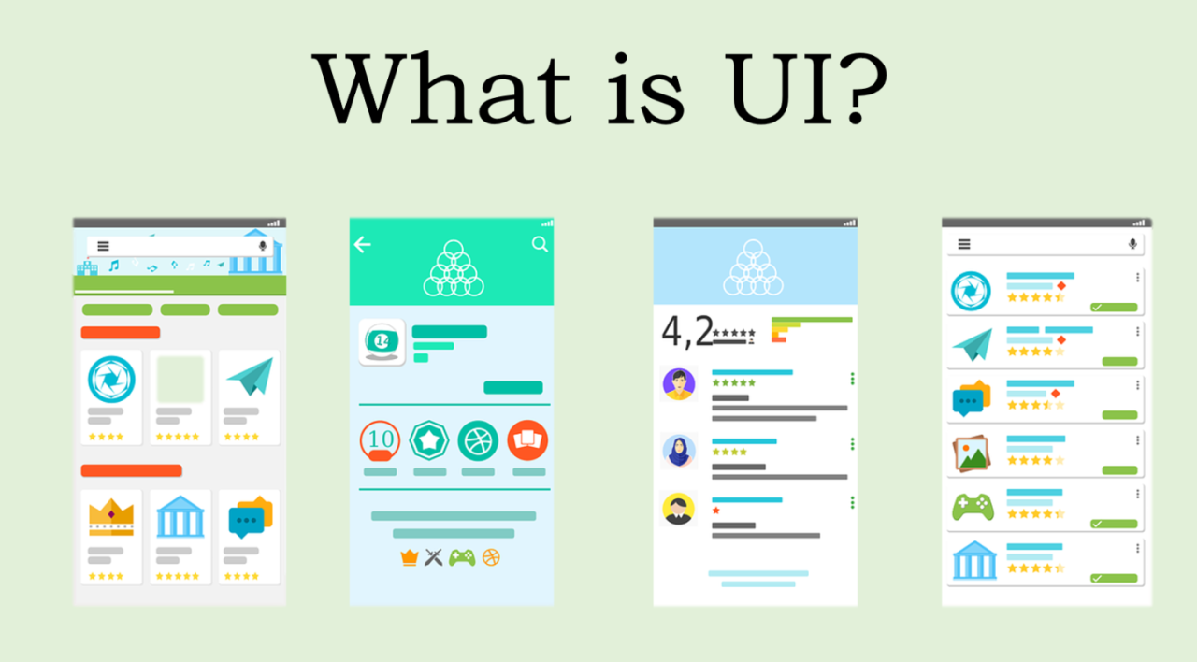

Slide 5

Understanding the proper use of UI
A scenario demonstrating the proper use of a User Interface (UI) would be a person using a weather app on their smartphone.
The UI of the weather app is visually appealing and easy to understand, with clear and concise text, bright colors, and intuitive icons.
The person is able to easily navigate to the home screen and select their location using the UI. They are able to quickly find and select their location from a list or by using the device's GPS capabilities.

Slide 6
Understanding the proper use of UI (cont.)
The UI displays the current weather conditions and forecast in an easy-to-read format, including temperature, wind speed, and chance of precipitation.
The person is able to view additional weather details, such as hourly and daily forecasts, by selecting the relevant icons on the UI.
The person is also able to customize their settings, such as units of measurement, using the UI. They are able to access these settings using an intuitive menu and make changes with just a few taps.

Slide 7

Understanding the proper use of UI (cont.)
The person is able to quickly and easily share the weather conditions and forecast with others using the “Share” option.
In this scenario, the proper use of the UI has allowed the person to quickly and easily access the information they need and complete their tasks with minimal effort. The UI is visually appealing and easy to understand, providing an enjoyable and efficient experience for the user.

Slide 8
Advantages of UI
User-Friendliness: A well-designed UI makes it easier for users to interact with a device, reducing the learning curve and increasing efficiency.
Visual Feedback: UI provides visual feedback to the user, making it easier to understand the state of a device and the results of actions taken.
Improved User Experience: A well-designed UI can greatly improve the overall user experience, making it more enjoyable and satisfying to use a device.

Slide 9
Advantages of UI (cont.)
Increased Productivity: A UI that is designed to be efficient and intuitive can increase productivity by reducing the time and effort required to complete tasks.
Accessibility: UI can be designed to be accessible to users with disabilities, making it possible for a wider range of people to use and benefit from a device.

Slide 10
Disadvantages of UI
Complexity: A UI that is overly complex and difficult to use can reduce efficiency and increase frustration for users.
Limitations: UI can be limited by the underlying technology, making it difficult to provide a seamless and consistent experience across different devices and platforms.
Resource Requirements: UI can be resource-intensive, requiring significant processing power and memory to function smoothly and efficiently.

Slide 11
Disadvantages of UI (cont.)
Dependence on Graphics: UI that relies heavily on graphics and visual elements can be difficult to use on devices with limited graphical capabilities.
Cost: Developing and maintaining a high-quality UI can be expensive, requiring specialized skills and resources.

Slide 12
Explain the basics of boot sequences, methods and startup utilities

Slide 13

Boot Sequences

Slide 14
Boot Sequences
What is boot sequence?
A boot sequence, also known as a boot process, is the sequence of steps that a computer system goes through in order to start up and become operational.
It is the process by which the computer hardware is initialized, the operating system is loaded into memory, and the system is made ready for use.

Slide 15
Boot Sequences (cont.)
The Process of Booting a Computer System
The process of booting a computer system starts with the activation of the power button.
This initiates the boot sequence, which includes the following stages:
Power-On Self Test (POST) - A series of tests performed to verify that the computer hardware is functioning correctly.
Loading the BIOS - The Basic Input/Output System is responsible for initializing the system hardware and preparing the system to boot.

Slide 16
Boot Sequences (cont.)
The Process of Booting a Computer System (cont.)
c. Selecting the Boot Device - The BIOS identifies and selects the boot device to load the operating system.
d. Loading the Boot Loader - The boot loader is a program that loads the operating system into memory.
e. Starting the Operating System - Once the operating system is loaded into memory, it takes control of the computer system and starts running.
These are the basic stages of the boot sequence. The specific steps and details may vary depending on the system configuration and the operating system being used.

Slide 17
Boot Methods

Slide 18
Boot Methods
Boot methods refer to the various ways in which a computer system can start up and begin the boot sequence
There are several boot methods available, each with its own advantages and disadvantages.

Slide 19
Boot Methods (cont.)
Most commonly used boot methods
Legacy BIOS Boot - The traditional boot method that uses the BIOS to boot the system. This method is still used in many older systems and is simple and reliable, but has limited support for newer technologies such as UEFI.
UEFI Boot - The Unified Extensible Firmware Interface is a modern boot method that replaces the legacy BIOS. It supports advanced features such as secure boot and fast boot, but requires more system resources than the legacy BIOS.

Slide 20
Boot Methods (cont.)
Most commonly used boot methods (cont.)
Network Boot - Also known as PXE boot, this method allows a computer system to boot from a network location rather than a local storage device. This is useful for large organizations that need to manage multiple systems remotely.
USB Boot - This method allows a computer system to boot from a USB drive, which can be useful for booting from a portable operating system or for performing a clean install of an operating system.

Slide 21
Boot Methods (cont.)
Advantages and Disadvantages of Boot Methods
Legacy BIOS Boot
Advantages: Simple and reliable, compatible with older systems
Disadvantages: Limited support for newer technologies, slower boot times
UEFI Boot
Advantages: Supports advanced features, faster boot times, more secure
Disadvantages: Requires more system resources, not compatible with older systems

Slide 22
Boot Methods (cont.)
Advantages and Disadvantages of Boot Methods (cont.)
Network Boot
Advantages: Convenient for managing multiple systems remotely
Disadvantages: Requires a network connection, can be slow due to network constraints
USB Boot
Advantages: Portable, useful for booting from a portable operating system or for performing a clean install
Disadvantages: Requires a USB drive, limited by the speed of the USB connection

Slide 23
Boot Methods (cont.)
Most Commonly Used Boot Methods
The most commonly used boot methods are UEFI and Legacy BIOS.
UEFI is becoming more widely used due to its advanced features and improved performance, but Legacy BIOS is still in use on many older systems.
The choice of boot method will depend on the specific requirements and capabilities of the computer system.

Slide 24
Startup Utilities

Slide 25
Startup Utilities
Startup utilities are software programs that are run during the boot sequence of a computer system.
They play a critical role in initializing and configuring the system, and can include tasks such as checking for disk errors, setting up the system clock, and loading device drivers.

Slide 26
Startup Utilities (cont.)
Several types of startup utilities
Boot Loaders - Boot loaders are responsible for loading the operating system into memory and starting the operating system. Examples include GRUB and LILO.
System Configuration Utilities - System configuration utilities allow users to configure the system settings and services that are started during the boot sequence. Examples include Syslinux and MSConfig.

Slide 27
Startup Utilities (cont.)
Several types of startup utilities (cont.)
Diagnostic Utilities - Diagnostic utilities are used to diagnose and troubleshoot problems with the system. Examples include memtest86 and SpinRite.
Rescue Utilities - Rescue utilities are used to recover a damaged or corrupted system. Examples include SystemRescueCD and Hiren's BootCD.

Slide 28
Startup Utilities (cont.)
Role of Startup Utilities
Startup utilities performs important tasks such as checking the system for errors, configuring system settings, and starting the operating system.
They provide a way for users to customize and optimize the boot process, and can be essential in troubleshooting and recovering from system problems.

Slide 29
Startup Utilities (cont.)
Examples of Startup Utilities
GRUB (GRand Unified Bootloader) - A popular boot loader that supports multiple operating systems and allows users to choose which operating system to boot.
Syslinux - A lightweight system configuration utility that allows users to customize the boot process and configure system services.

Slide 30
Startup Utilities (cont.)
Examples of Startup Utilities (cont.)
Memtest86 - A diagnostic utility that tests the system memory for errors.
SystemRescueCD - A rescue utility that provides a live CD environment for troubleshooting and recovering a damaged or corrupted system.

Slide 31

Let’s do some exercises!

Slide 32
Exercises
Define what a boot sequence is and describe the steps involved in the process.
Draw a flowchart to illustrate the boot sequence process.
Identify the different stages of a boot sequence and explain the role of each stage.
Compare and contrast the different boot methods, such as BIOS and UEFI.
Write a short paragraph explaining the advantages and disadvantages of each boot method.
Identify the various types of startup utilities and explain their role in the boot sequence.
Write a short paragraph explaining the difference between system and boot files in the boot sequence.

Slide 33
Exercises (cont.)
8. Explain how the boot process differs between different operating systems, such as Windows, Linux, and MacOS.
9. Conduct online research to find and explain a recent innovation in boot sequences, such as secure boot or fast boot.
10. Create a table comparing and contrasting the different boot methods and startup utilities.
11. Explain the role of boot loaders in the boot sequence.
12. Divide in 2 groups and analyze the boot process of a computer system and identify any potential performance bottlenecks.
13. Write a short paragraph explaining the benefits of having a fast and efficient boot sequence.

Slide 34
Exercises (cont.)
14. Discuss the challenges and limitations of boot sequences, such as compatibility with different hardware configurations.
15. Discuss the future of boot sequences, such as the trend towards faster and more secure boot methods.
16. Create a diagram illustrating the interactions between different components in the boot sequence, such as the system firmware, boot loader, and operating system.
17. Explain how boot sequences can be used for system administration tasks, such as installing new software or updating system files.
18. Divide in 2 groups and discuss the challenges and considerations when deploying boot sequences on different types of hardware, such as laptops, servers, and embedded systems.

Slide 35
Exercises (cont.)
19. Write a short paragraph explaining the role of boot sequences in enabling the functionality of a computer system.
20. Imagine you have a dual-boot system with both Windows and Linux operating systems, how would you access files from one operating system from the other, given their different directory structures?
21. Explain the importance of consistency in UI design and give an example of how this can be achieved.
22. Discuss the role of visual design in UI, including color, typography, and layout.
23. Describe the difference between a good and bad UI and provide examples of each.

Slide 36
Exercises (cont.)
24. Discuss the role of accessibility in UI design, including the importance of making interfaces usable for people with disabilities.
25. Explain the importance of providing immediate feedback to users in a UI and give an example of how this can be done.

Slide 37

Thanks!

